Slide 1

Examination of Student Demographic and Socioeconomic Data to Predict College Dropout Risk
Group 7: Sarah Bryant and Phillip Tarpley
Notes:
Hello and welcome to the Final Project presentation for Group 7 in BIT 5534 by Sarah Bryant and Phillip Tarpley. The title for our presentation is The Examination of Student Demographic and Socioeconomic Data to Predict College Dropout Risk. During this presentation, we will review the business objective, model preparation and execution, as well as the conclusion of our data analysis including recommended next steps.

Slide 2

Business Problem
Around 40% of undergraduate students leave universities and colleges every year.
Students that leave college and don’t go on to earn a degree elsewhere, end up earning tens of thousands less than college graduates per year, and have a greater risk of living in poverty.
A valued $3.8 billion is lost each year as a result of college dropouts.
Universities and colleges have limited funding to put towards intervention strategies. Being able to better predict which students are most at risk of dropping out will support the most effective use of that funding.
Notes:
College dropout rates are a major concern for colleges and universities, from many different perspectives in particular from a financial point of view. Colleges depend on student tuition in order to operate which is ultimately lost revenue when a student drops out of college.
Per the Education Data Initiative published in 2021, around 40% of undergraduate students leave universities and colleges every year. Students that leave college and don’t go on to earn a degree elsewhere, end up earning tens of thousands less than college graduates per year, and have a greater risk of living in poverty. An estimated 3.8 billion dollars are lost every year by universities due to students dropping out. Funding for counseling and other programs to assist students are generally very limited which makes applying these resources as efficiently as possible critical to the success of students and in turn the university. Finding more effective ways of helping students succeed is beneficial for the financial success of universities and also benefits the student by completing their education.

Slide 3

Business Objectives
Overarching
Help students reach graduation and collect tuition fees to pay for school operations.
Objective One
Identify what factors or combination of factors place a student at a higher risk of dropping out.
Objective Two
Develop appropriate intervention strategies targeted toward the most at-risk students.
Our analysis focused on objective one.
Notes:
The goal of this analysis is to provide the colleges and universities with potential predictors for students who may be at a higher risk of dropping out so they could work to mitigate those risks and structure counseling and student assistance with these predictors in mind. This would allow colleges to more efficiently assist students who are at higher risk of dropping out and ideally lower the number of dropouts per year.
The overarching goal is to help students reach graduation and in turn collect tuition payments for the financial success of the institution. Successful students will equal successful universities.
Objective one, which is the focus of our data analysis, is to identify which factors, or combination of factors, could be used as predictors for students that are at a higher risk of dropping out. We can use these factors to create a predictive model for colleges and universities to use to predict the dropout risk for students.
Objective two is to develop appropriate counseling and intervention strategies to help high risk students from dropping out. This would be the next step for a university using our data analysis once high risk factors, if any, are indicated and a predictive model is created to evaluate a student’s risk for dropping out.

Slide 4
Data Description
We used a dataset available on Kaggle.com which provided social, economic and academic data for students enrolled in an undergraduate degree program offered at a higher education institution.
The dataset contains 4,424 observations, each with 35 variables, including the target variable indicating if the student dropped out, graduated, or was still enrolled.
Since we were only interested in students that either graduated or dropped out, we removed the 794 observations from the data that were for “enrolled” students. We also excluded 152 observations for students who were not enrolled in any curricular units for the 1st and 2nd semester. This left us with 3,478 observations for our analysis.
Notes:
Previous studies have pointed to a number of demographic, socioeconomic, macroeconomic and academic factors that play a role in an individual dropping out of college. For our analysis, we used a dataset available on Kaggle.com related to students enrolled in an undergraduate degree program offered at a higher education institution. The dataset contained thousands of records and over thirty points of data related to the areas that factor into a student dropping out.
The dataset includes demographics regarding the students including age at enrollment, the nationality of the student, and the marital status of the student. The data also includes socioeconomic statistics regarding the education level for each of the students parents as well as the parents’ occupations. Some macroeconomic variables that are included in this dataset include the unemployment rate, inflation rate, and gross domestic product of the students’ home region.

Slide 5
Methods
To develop our model, we first generated and analyzed descriptive analytics and visualizations and conducted multivariate analysis. Then using the information we obtained from those activities we conducted analysis using nominal logistic regression, principal component analysis and neural network analysis.
Relevant performance measures:
Generalized R²
Root Mean Squared Error (RMSE) and Root Average Squared Error (RASE)
p-values
Eigenvalues
Notes:
To develop our model, we first generated and analyzed descriptive analytics and visualizations and conducted multivariate analysis. Then using the information we obtained from those activities we conducted nominal logistic regression, neural network analysis and principal component analysis.
Before applying the techniques, we used JMP to analyze distributions, generate histograms, boxplots and frequencies for all of the categorical variables, and summary statistics for all of the quantitative variables. To examine the relationships between the categorical variables and the target variable, we generated contingency tables and mosaic plots. We also generated a scatterplot matrix and correlation matrix to examine the relationship between the continuous variables but identified no strong correlations.

Slide 6
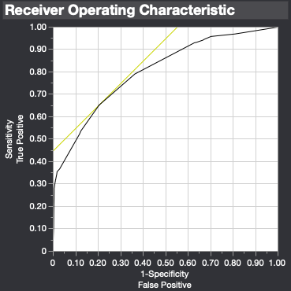
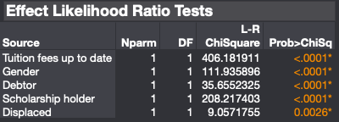
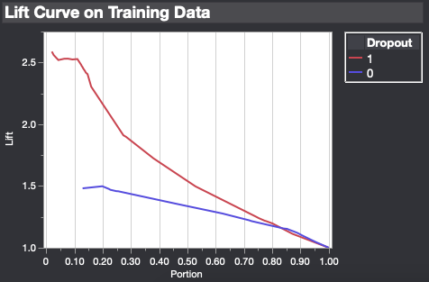
Empirical Results - Nominal Logistic Regression
Notes:
For our first parametric technique, we conducted a nominal logistic regressionv model using the variables identified as having p-values < 0.0001 in the previous multivariate analysis step, which were: debtor (D), tuition fees up to date (T), gender (G), scholarship holder (S) and displaced (Di). The model resulted in a generalized RSquare value of 0.3921, a Root Average Squared Error of 0.4069 and a misclassification rate of 0.2562.
In general, these statistics show the lack of fit for the logistic regression model and this dataset. The logistic regression model is only able to explain 39.2% of the variance in this dataset which does not show a strong enough correlation for this model to be used as a predictive model in this scenario. This also indicates these specific variables may not be key indicators in the success for students.

Slide 7
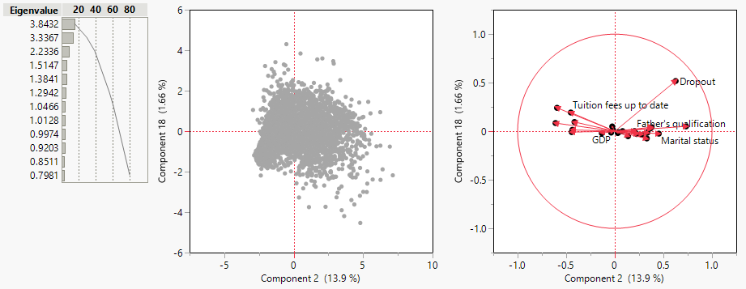
Empirical Results - PCA
Notes:
For our nonparametric technique, we chose to conduct principal component analysis. The dataset generated 24 principal components which were evaluated to determine how many components should be utilized in the regression model. Principal Component 1 resulted in an eigenvalue of 3.84 which was the highest for the dataset accounting for 16.01% of the variation. Prin2 was not far behind and calculated an eigenvalue of 3.34 and accounting for 13.9% of the variation. The remainder of the principal components’ eigenvalues steadily decrease for the remainder of the calculated fields.
After reviewing the eigenvalues and scree plot (it was determined to use enough principal components to account for at least 80% of the variation in the dataset. This required that 12 principal components be used in the regression model which ultimately accounted for 80.14% of the variation. There were “elbows” in the scree plot, but not significant enough to warrant using the plot to determine the number of components to use.
The Fit Least Squares model using the principal components resulted in a strong predictive model with an R² of 0.7092 and an Root Mean Square Error of 0.26. Evaluating the principal components individually, show how effective tightly correlated these principal components are which allows them to function as good predictors. Principal Component 1, Principal Component 2, Principal Component 3, and Principal Component 4 have nearly immeasurable p-values. The p-values remain relatively low for the top 9 performing components, less than 0.001, until Principal Component 11 increases to 0.022

Slide 8
Empirical Results - Neural Network
Results of analysis using 24 variables:
 | 1 Tour |  | 5 Tours |  | 10 Tours
Models | Gen. R² | RASE | Gen. R² | RASE | Gen. R² | RASE
0 Training | 0.7356 | 0.2807 | 0.7628 | 0.2732 | 0.7346 | 0.2879
0 Validation | 0.5921 | 0.3360 | 0.6928 | 0.3085 | 0.6871 | 0.3070
1 Training | 0.6998 | 0.3006 | 0.7416 | 0.2840 | 0.7520 | 0.2794
1 Validation | 0.6296 | 0.3274 | 0.6866 | 0.3085 | 0.6999 | 0.3027
5 Training | 0.7375 | 0.2819 | 0.7590 | 0.2762 | 0.7327 | 0.2858
5 Validation | 0.6873 | 0.3101 | 0.7058 | 0.3029 | 0.6888 | 0.3086
Notes:
For the third technique, we conducted multiple neural network analysis using only the same five variables we used for our nominal logistic regression, and an additional set of analysis using all of the independent variables. For each set of independent variables we conducted a total of nine analyses, using different numbers for the model parameter (0, 1 and 5) and different numbers for the tour parameter (1, 5 and 10).
While there was little variation between the resulting generalized R² and Root Average Squared Error when the parameters were changed, we saw significantly better results with the analysis which used all of the independent variables.
The best results for the neural network that used the five variables identified for the logisitc regression model had a generalized R² of 0.3968 and a Root Average Squared Error of 0.4040 for the training data and a generalized R² of 0.4171 and a Root Average Squared Error of 0.4021 for the validation data. This could be an indicator that the five variables selected for this analysis had a lower correlation to the target variable than the original data evaluations showed.
In comparison, the best results for the neural network which used all of the 24 independent variables had a generalized R² of 0.7590 for the training set and 0.7058 for the validation set. This model also produced a lower Root Average Squared Error of 0.2762 and 0.3029 for the training and validation sets respectively. This model was able to account for over 70% of the variation in the dataset and do so with a relatively low error rate.

Slide 9
Findings
Economic variables combined play the biggest role in a college student dropping out, but other factors contribute as well. Using 12 principal components we were able to build a fairly strong predictive model, which a college could use to target its intervention strategies. Our neural network model was also had fairly strong predictive capabilities, but with 24 variables, it is more unwieldy to collect and act on all of the variables.
Our findings confirmed that an individual dropping out of college is often the result of many factors, not just any one specific issue. However, using these findings, the college can take more proactive intervention strategies with students identified as being at risk using the predictive model we’ve developed.
Notes:
From our findings, the logistic regression model was not a valid predictor for the dataset as there was just not enough correlation between the model and the data, the principal component model using 12 principal components had strong predictive capabilities and could be employed by the college to identify at-risk students. The neural network analysis using 24 variables also showed strong predictive capability and the results support previous studies which identified a number of demographic, socioeconomic, macroeconomic and academic factors influencing drop-out rates. The college can use these findings to build an early warning system and target its intervention strategies at those students most at risk.

Slide 10
Recommendations
Develop an “early warning system” that checks the data on new and existing students to identify those at risk of dropping out.
Offer online courses to make studies more accessible for all students, giving them the chance to work at the same time and build their own schedule.
Offer students on-campus support and counselling, in order to understand what students are going through, and provide them with solutions.
Notes:
We have developed three core recommendations that can be acted upon by universities to improve dropout rates based on the findings of our analysis:
1. Develop an “early warning system” that checks the data on new and existing students to identify those at risk of dropping out.
This would involve the university ultimately plugging student data into our predictive model to assess the risk for each particular student and categorize students as “high risk”.
2. Offer online courses to make studies more accessible for all students, giving them the chance to work at the same time and build their own schedule.
Online courses could play a role in the success of students by allowing more flexibility.
3. Offer students on-campus support and counselling, in order to understand what students are going through, and provide them with solutions.
This counseling and support could be used in a more proactive way for students that have been identified as high risk.
Ultimately it is the responsibility of the university and the student to overcome potential barriers that may be in the way of student success in college. The key is to utilize our predictive model to identify those students that are at a higher risk for dropping out and ensuring they have the resources they need to be successful and graduate.

